Slide 1

CSCI 476: Computer Security
Lecture 5: Set-UID and Environment Variables
Reese Pearsall
Fall 2022
*all images are stolen from the internet
https://www.cs.montana.edu/pearsall/classes/fall2022/476/main.html

Slide 2
Announcements
Lab 1 Due FRIDAY 9/16 @ 11:59 PM
Shouldn’t be too bad
Note taker still needed

Slide 3
How would you protect your computer and its resources?

Slide 4
Access Control
who can do what to whom?
users/groups
what is their identity?
Objects
Usually things on a filesystem
permissions (read/write/execute)
Ok, I know the who– what are you permitted to do?

Slide 5
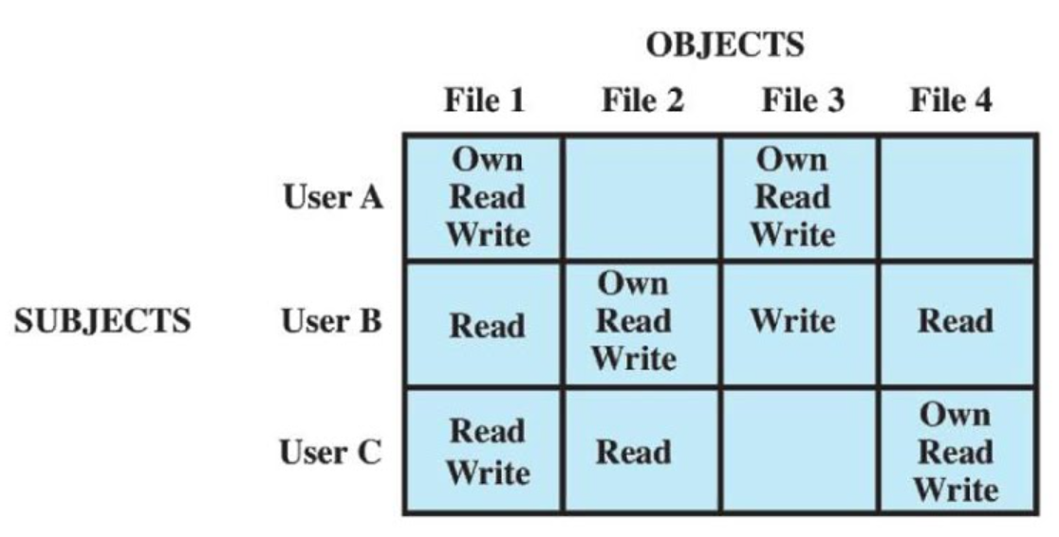
who can do what to whom?
Access Control
Access Control Matrix
What are some issues with this?

Slide 6
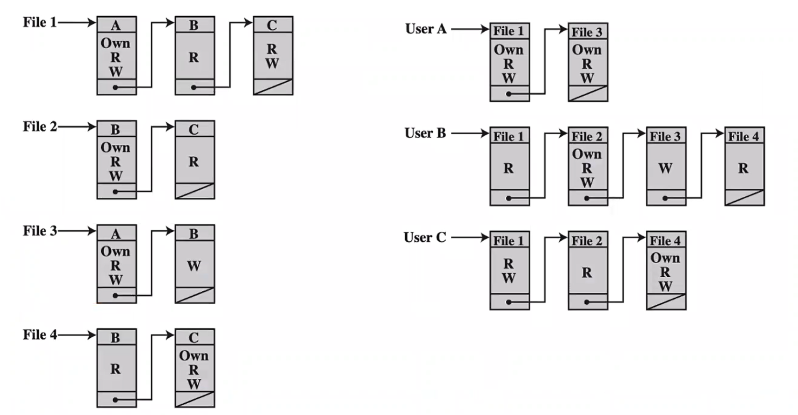
who can do what to whom?
Access Control
Wont take up as much memory!
Access Control list (ACL)

Slide 7
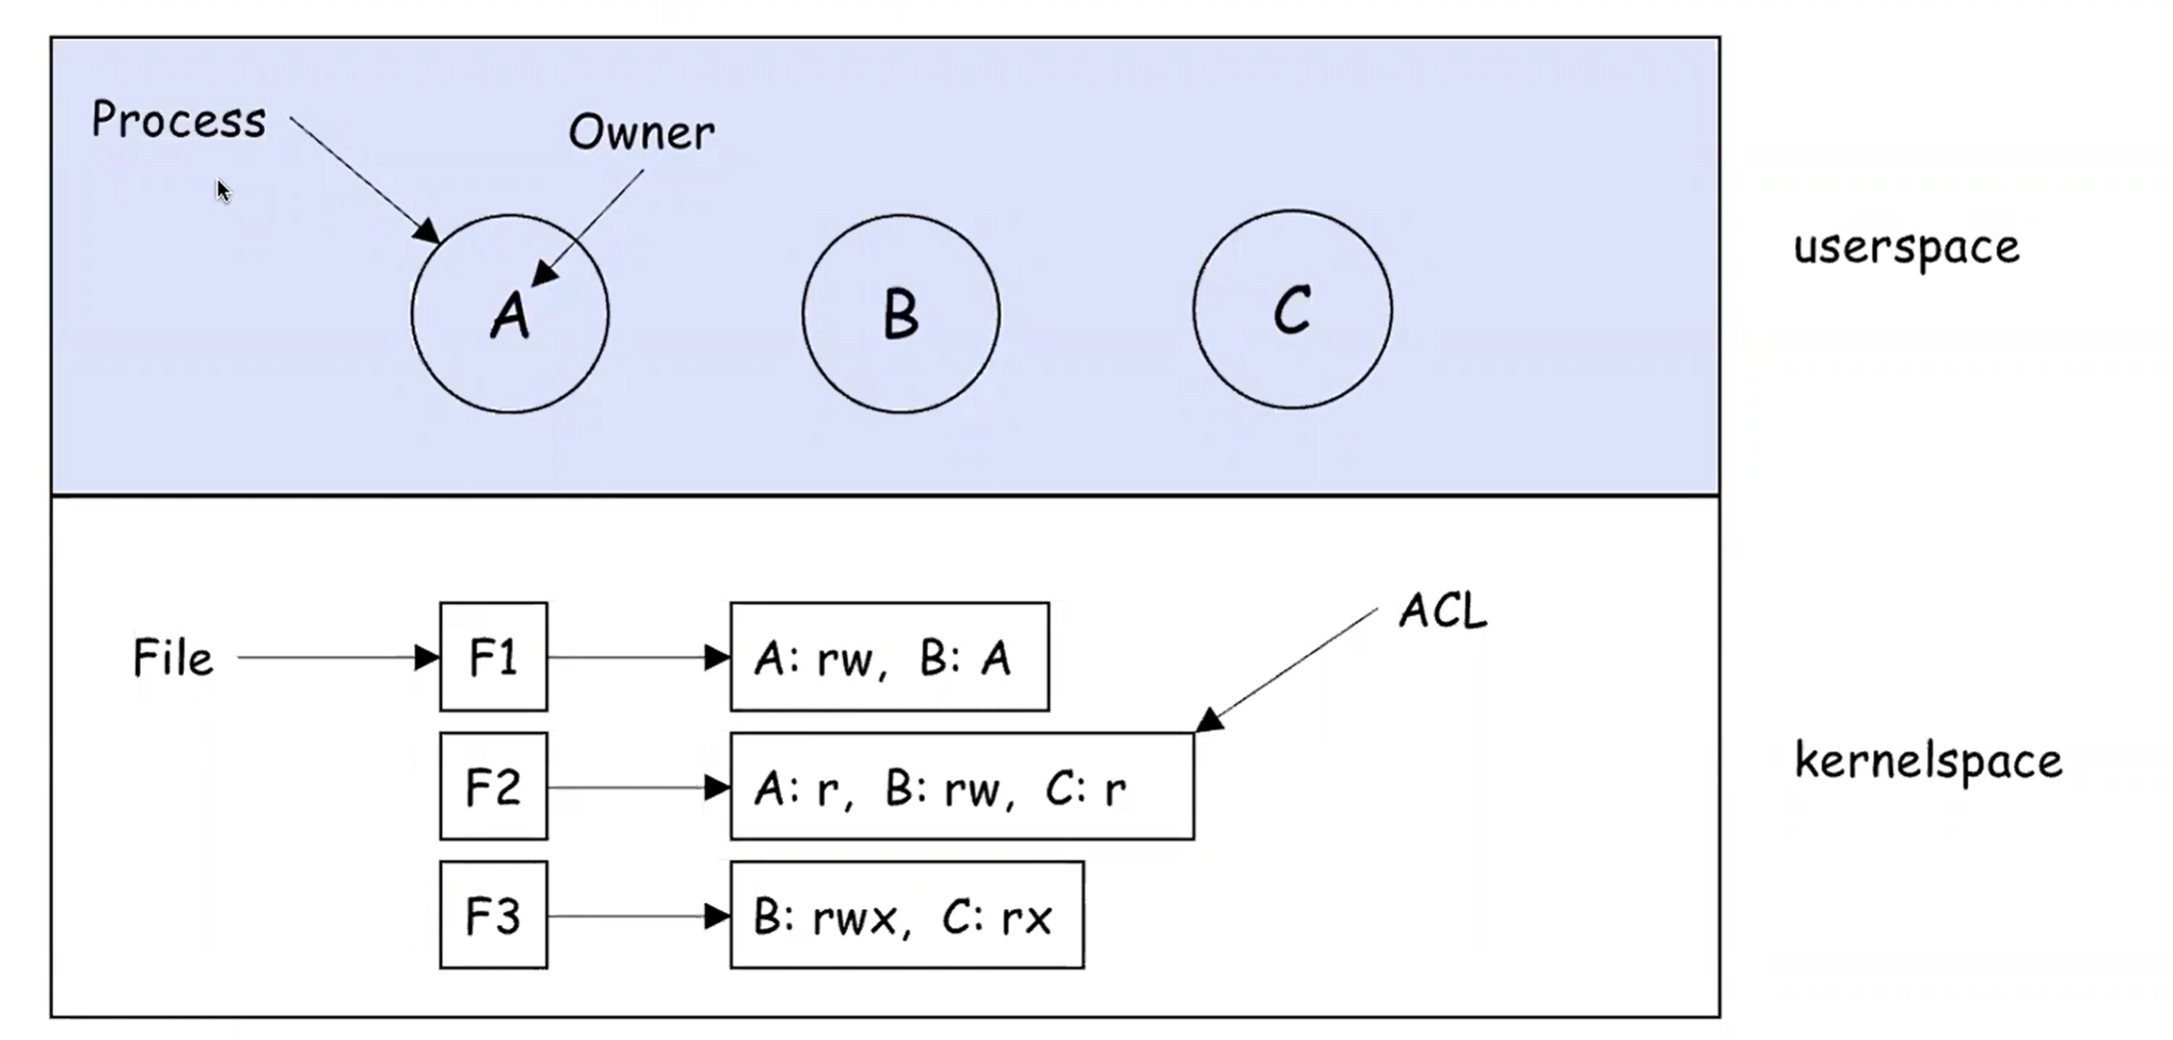
who can do what to whom?
Access Control

Slide 8
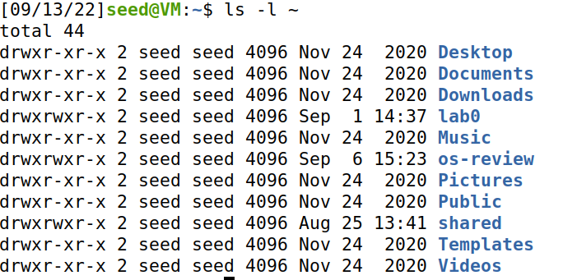
Unix File Modes and Permissions
Every Unix file has a set of permissions that determine whether someone can read, write, or run the file
ls –l ~
ls –l /dev

Slide 9
Unix File Modes and Permissions
Every Unix file has a set of permissions that determine whether someone can read, write, or run the file
ls –l ~
ls –l /dev
Permissions for the file

Slide 10
Unix File Modes and Permissions
Every Unix file has a set of permissions that determine whether someone can read, write, or run the file
Owner/group information
ls –l ~
ls –l /dev
Permissions for the file

Slide 11
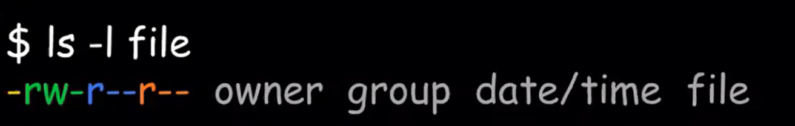
Unix File Modes and Permissions
Every Unix file has a set of permissions that determine whether someone can read, write, or run the file
File permissions (4 parts)
[file type][user][group][other]

Slide 12
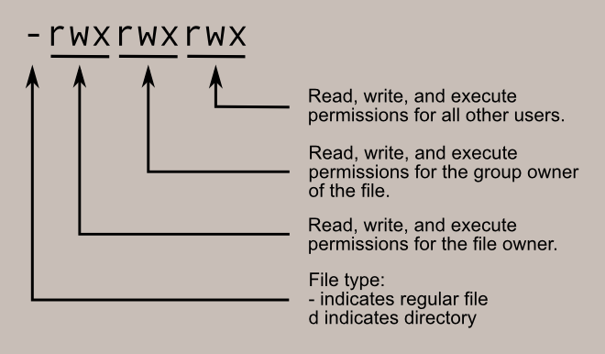
Unix File Modes and Permissions
File permissions (4 parts)
[file type][user][group][other]

Slide 13
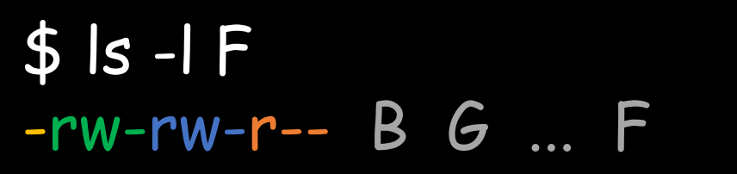
Unix File Modes and Permissions
[file type][user][group][other]
Suppose you have the following file:
If user A asks to perform some operation O on a file object F, the OS checks:
Is A the owner of F?

Slide 14

Unix File Modes and Permissions
[file type][user][group][other]
Suppose you have the following file:
If user A asks to perform some operation O on a file object F, the OS checks:
Is A the owner of F?
No, B is the owner

Slide 15
Unix File Modes and Permissions
[file type][user][group][other]
Suppose you have the following file:
If user A asks to perform some operation O on a file object F, the OS checks:
Is A the owner of F?
Is A a member of F’s group?

Slide 16

Unix File Modes and Permissions
[file type][user][group][other]
Suppose you have the following file:
If user A asks to perform some operation O on a file object F, the OS checks:
Is A the owner of F?
Is A a member of F’s group?
Suppose G = {B,C,F}
A is not in F’s group

Slide 17
Unix File Modes and Permissions
[file type][user][group][other]
Suppose you have the following file:
If user A asks to perform some operation O on a file object F, the OS checks:
Is A the owner of F?
Is A a member of F’s group?
Otherwise, what can they do?

Slide 18

Unix File Modes and Permissions
[file type][user][group][other]
Suppose you have the following file:
If user A asks to perform some operation O on a file object F, the OS checks:
Is A the owner of F?
Is A a member of F’s group?
Otherwise, what can they do?
Everyone can read file F

Slide 19
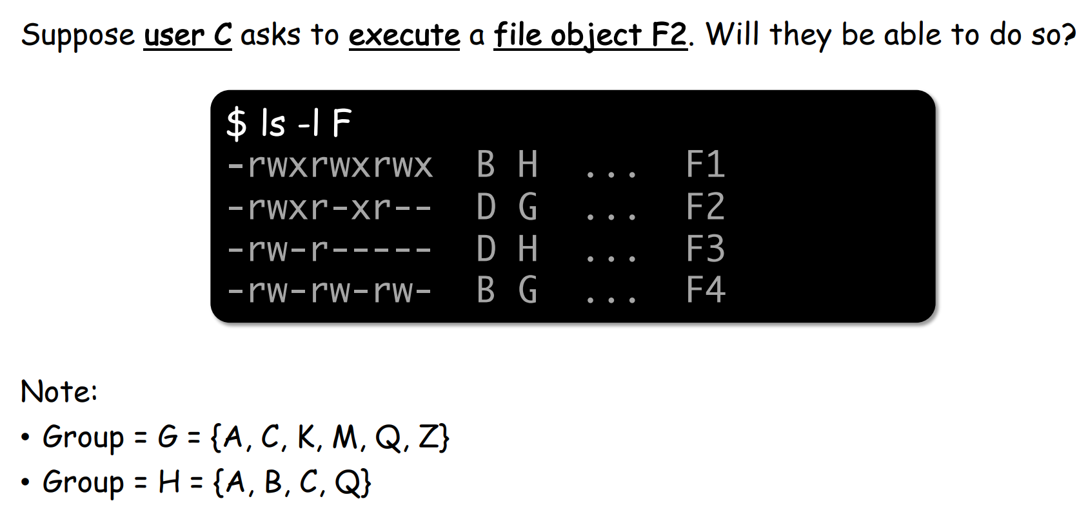
Unix File Modes and Permissions
[file type][user][group][other]

Slide 20


Unix File Modes and Permissions
[file type][user][group][other]

Slide 21
Limitations of File-Based Access Control
When would a non-privilege user require more power/permissions?

Slide 22
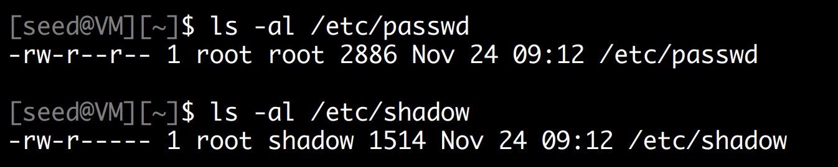
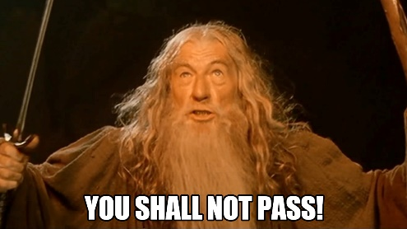
Limitations of File-Based Access Control
When would a non-privilege user require more power/permissions?
Changing password!

Slide 23
Limitations of File-Based Access Control
When would a non-privilege user require more power/permissions?
Changing password!
/etc/passwd and /etc/shadow hold encrypted passwords for the user, in order to change our password, we will need to have access to those directories

Slide 24
Limitations of File-Based Access Control
When would a non-privilege user require more power/permissions?
Changing password!
/etc/passwd and /etc/shadow hold encrypted passwords for the user, in order to change our password, we will need to have access to those directories
root (aka admin) is the only person that has write permissions!

Slide 25
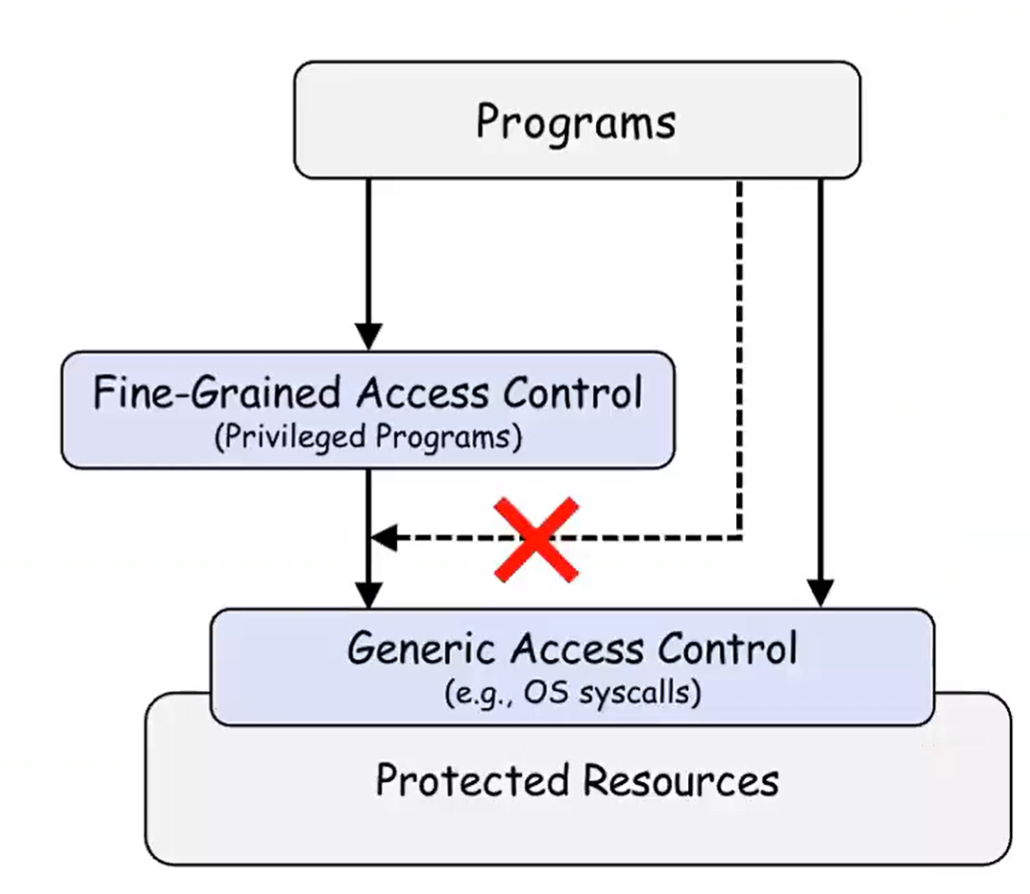

Limitations of File-Based Access Control
Instead of having a user deal with sensitive actions, lets have a privileged program do it for us!

Slide 26
Types of Privileged Programs
Daemons
Computer program that runs in the background
Needs to run as root or other privileged users
Set-UID Programs
Widely used in UNIX systems
A normal program… but marked with a special bit

Slide 27

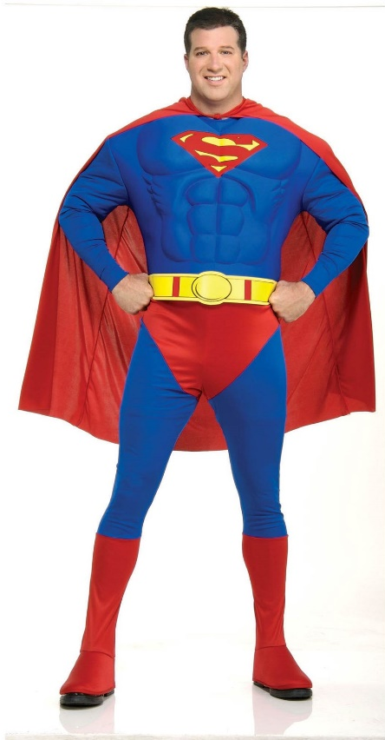
The superman story
Superman got tired of saving the city every day
So, he decided to create a “super suit” that would give normal people his powers
Problem: Not all super people are good………

Slide 28
The superman story
Superman got tired of saving the city every day
So, he decided to create a “super suit” that would give normal people his powers
Problem: Not all super people are good………
Super suit 2.0
Super suit with a dope computer
Programmed to perform a specific task
No way to deviate from the pre-programmed task

Slide 29
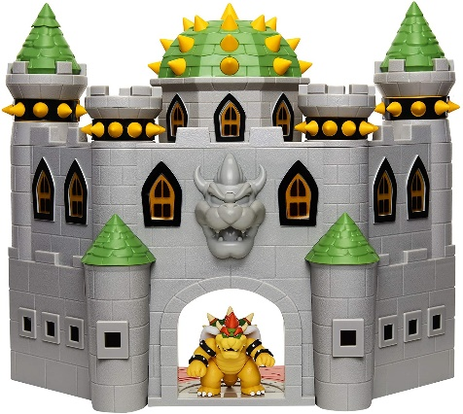


The superman story
Task: Stop Bowser
Fly North
Turn left and move forward
Punch
Super suit 2.0
People can hop in, and do the specific task to stop bowser

Slide 30
The superman story
Task: Stop Bowser
Fly North
Turn left and move forward
Punch

Slide 31
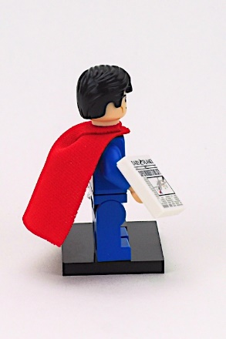
The superman story
Task: Stop Bowser
Fly North
Turn left and move forward
Punch

Slide 32
The superman story
Task: Stop Bowser
Fly North
Turn left and move forward
Punch

Slide 33
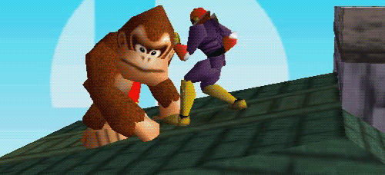
The superman story
Task: Stop Bowser
Fly North
Turn left and move forward
Punch

Slide 34
The superman story
Task: Stop Bowser
Fly North
Turn left and move forward
Punch
This works great! People can only do the predetermined task and don’t have control!

Slide 35
The superman story
Task: Stop Bowser
Fly North
Turn left and move forward
Punch
This works great! People can only do the predetermined task and don’t have control!
Exploitable?

Slide 36

The superman story
Task: Stop Bowser
Fly North
Turn left and move forward
Punch
Suppose I come along, and I see the power suit
And I decide to flip the suit around
Now what happens???

Slide 37
The superman story
Task: Stop Bowser
Fly North
Turn left and move forward
Punch
Suppose I come along, and I see the power suit
And I decide to flip the suit around
Now what happens???

Slide 38
The superman story
Task: Stop Bowser
Fly North
Turn left and move forward
Punch
Suppose I come along, and I see the power suit
And I decide to flip the suit around
Now what happens???

Slide 39
The superman story
Task: Stop Bowser
Fly North
Turn left and move forward
Punch
Suppose I come along, and I see the power suit
And I decide to flip the suit around
Now what happens???

Slide 40
The superman story
Task: Stop Bowser
Fly North
Turn left and move forward
Punch
Suppose I come along, and I see the power suit
And I decide to flip the suit around
Now what happens???

Slide 41

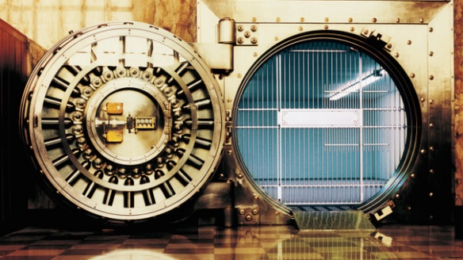
The superman story
Task: Stop Bowser
Fly North
Turn left and move forward
Punch
Suppose I come along, and I see the power suit
And I decide to flip the suit around
I still followed the steps, but now we have a totally different outcome
My plan was to rob the bank, and I had friends waiting this whole time!

Slide 42
Set-UID In a Nutshell
Set-UID allows a user to run a program with the program owner’s privilege
User runs a program w/ temporarily elevated privileges
Created to deal with inflexibilities of UNIX access control
Example: The passwd program

Slide 43

Set-UID In a Nutshell
Set-UID allows a user to run a program with the program owner’s privilege
User runs a program w/ temporarily elevated privileges
Every process has two User IDs
Real UID (RUID)– Identifies the owner of the process
Effective UID (EUID)– Identifies current privilege of the process
When a normal program is executed
RUID == EUID
If a program owner == root,
The program runs with root privileges
When a Set-UID program is executed
RUID != EUID
EUID == ID of the program’s owner

Slide 44
Set-UID In a Nutshell
Set-UID allows a user to run a program with the program owner’s privilege
User runs a program w/ temporarily elevated privileges
Every process has two User IDs
Real UID (RUID)– Identifies the owner of the process
Effective UID (EUID)– Identifies current privilege of the process
When a normal program is executed
RUID == EUID
If a program owner == root,
The program runs with root privileges
When a Set-UID program is executed
RUID != EUID
EUID == ID of the program’s owner

Slide 45
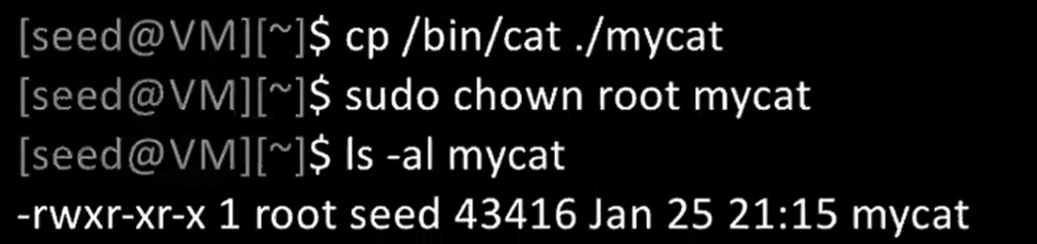
Set-UID Program Demo
Change the owner of a file to root

Slide 46
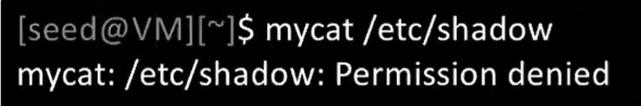
Set-UID Program Demo
Change the owner of a file to root
Running to program (normally)

Slide 47
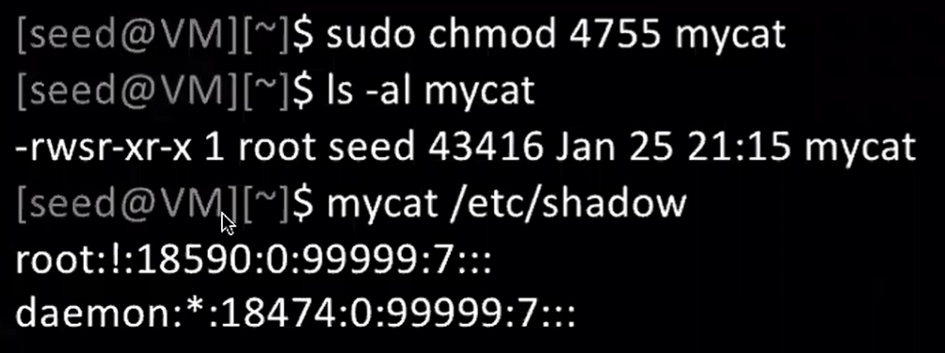

Set-UID Program Demo
Change the owner of a file to root
Running to program (normally)
Enable the Set-UID bit
We have successfully made a Set-UID program!

